Slide 1




PEUQSE Workshop
Installation instructions – www.chemsoftware.org
“By the end of this workshop…”
You should be able to run a simple BPE
You should know how to change the sampler
You should know how to start a single sampling from a specific place in parameter space
You should know how to run a multi-start sampling
You should know how to check for convergence.
You should know how to make a point a zero probability for a failed simulation within your simulation wrapper.
Abhishek T. Sose, Troy Gustke, and Aditya (Ashi) Savara
Date
08/25/2022
1

Slide 2

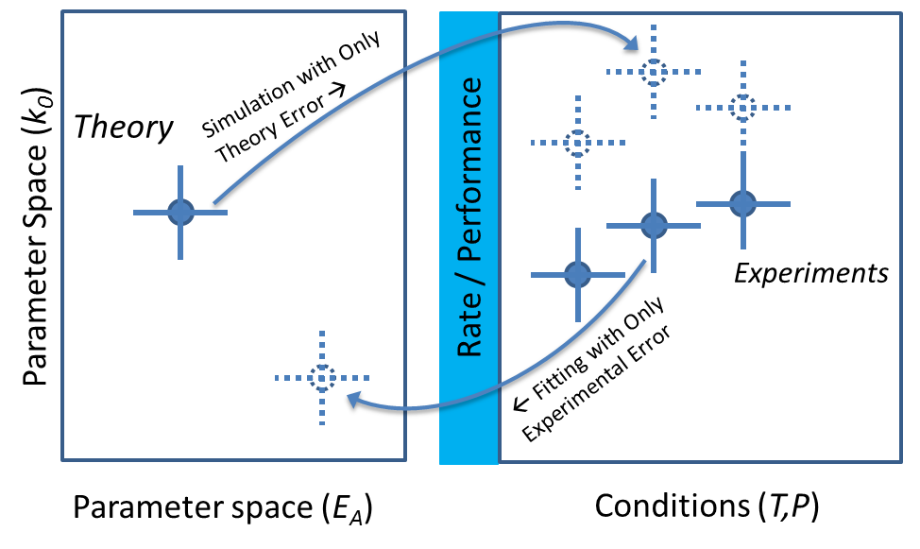
Aim 0: Bayesian vs conventional Parameter Estimation
Conventional error propagation is 1-way: either from theory to simulation or fitting with inclusion of experimental error.
2
Savara, A. et. al. “Progress in Accurate Chemical Kinetic Modeling, Simulations, and Parameter Estimation for Heterogeneous Catalysis”. ACS Catal. 2019, 9, 8, 6624-6647.

Slide 3
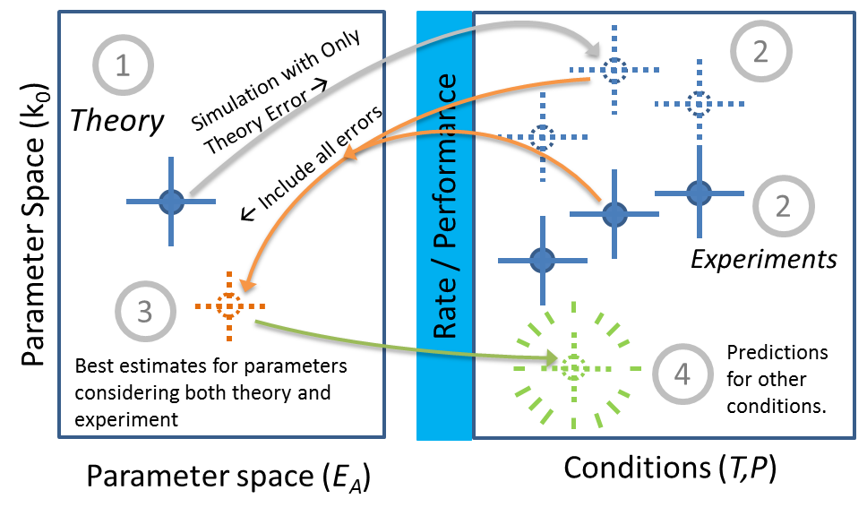
Aim 0: Bayesian vs conventional Parameter Estimation
Bayesian parameter estimation is 2-way, the error/uncertainty from experiment and theory are considered together, giving a consolidated “best guess” for the correct parameters.
3
Savara, A. et. al. “Progress in Accurate Chemical Kinetic Modeling, Simulations, and Parameter Estimation for Heterogeneous Catalysis”. ACS Catal. 2019, 9, 8, 6624-6647.

Slide 4
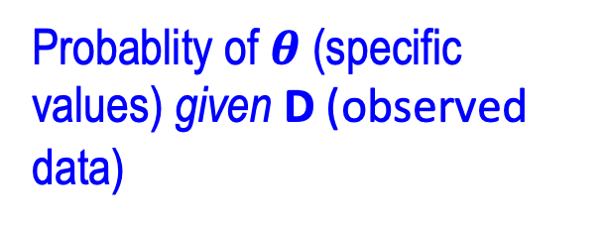
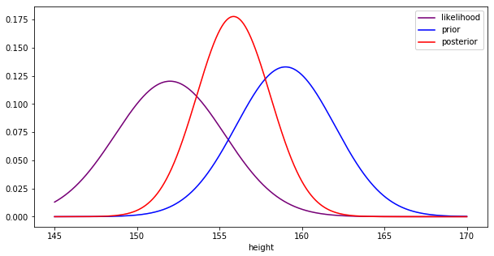
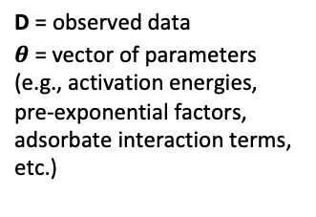
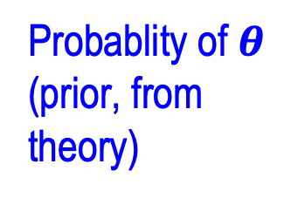
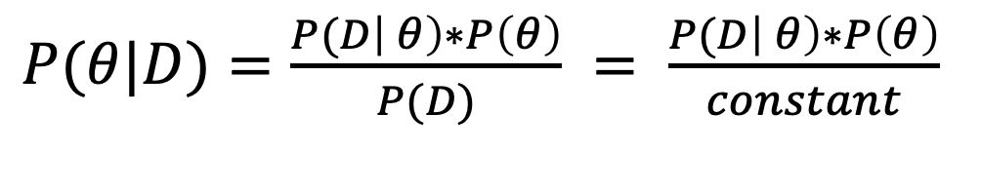
Aim 0: Introduction to Bayesian Analysis
Robust posterior predictions of quantities of interest (QOIs) are obtained by taking into account the updated (posterior) uncertainties in the model parameters θ given the data, D.
Probablity of D (observed data) given $θ$ (specific values)
Bayes’ Theorem:
D = observed data
$θ$ = vector of parameters (e.g., activation energies, pre-exponential factors, adsorbate interaction terms, etc.)
$P(θ|D)=\frac{P(D\left| θ\right)∗P\left(θ\right)}{P(D)} = \frac{P(D\left| θ\right)∗P\left(θ\right)}{constant}$
Probablity of $θ$ (prior, from theory)
Probablity of $θ$ (specific values) given D (observed data)
https://miro.medium.com/max/1216/1*rP6v9jssJrm_leW3WHnguA.png
4
Savara, A. et. al. “Progress in Accurate Chemical Kinetic Modeling, Simulations, and Parameter Estimation for Heterogeneous Catalysis”. ACS Catal. 2019, 9, 8, 6624-6647.

Slide 5
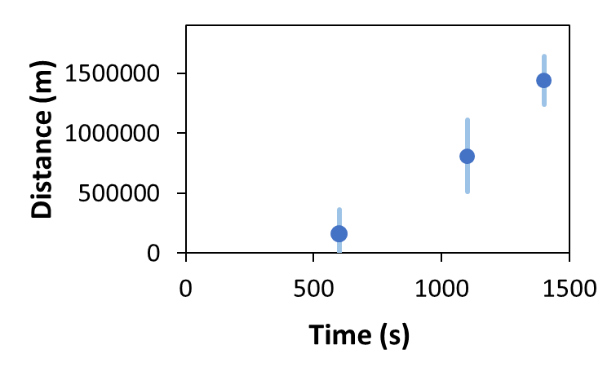
Aim 1: Bayesian vs conventional Parameter Estimation
Example: Given 3 data points: {x₁,y₁}, {x₂,y₂}, {x₃,y₃}. Use the curve y = (x-a)**2 + b to solve for a and b.
Open observed_values.py to see
Their values, including uncertainties, are:
y₁ = 160500 +/- 200000 (for x₁ = 600 )
y₂ = 810500 +/- 300000 (for x₂ = 1100 )
y₃ = 1440500 +/- 200000 (for x₃ = 1400 )
Conventional Parameter Estimation (CPE): | Bayesian Parameter Estimation (BPE):
Optimize the “Objective Function” is typically a weighted sum of squared residuals (WSSR). Overfitting may occur | Find most probable set of parameters, based on prior assumptions (i.e., physical beliefs) Can access physically realistic values
Goal: Minimize SSR | Goal: Maximize logP
TO DO
Run directory 1:
5
Savara, A. et. al. “Progress in Accurate Chemical Kinetic Modeling, Simulations, and Parameter Estimation for Heterogeneous Catalysis”. ACS Catal. 2019, 9, 8, 6624-6647.

Slide 6
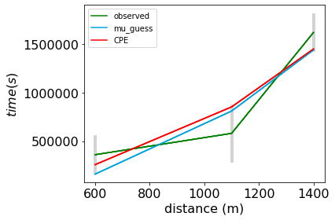
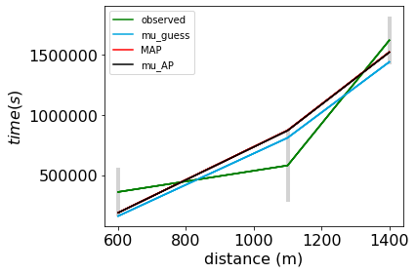
Aim 1: Bayesian vs conventional Parameter Estimation
Where we know that the physically realistic values of “a” and “b” are:
Prior anticipated value of a = 200 +/- 100 (this is the 1 sigma confidence interval)
Prior anticipated value of b = 500 +/- 200 (this is the 1 sigma confidence interval)
Conventional Parameter Estimation (CPE): | Bayesian Parameter Estimation (BPE):
Goal: Minimize SSR | Goal: Maximize logP
a = 255, b = 139153 | a = 166 +/- 57, b= 509 +/- 198
TO DO
Run directory 1:
6
Savara, A. et. al. “Progress in Accurate Chemical Kinetic Modeling, Simulations, and Parameter Estimation for Heterogeneous Catalysis”. ACS Catal. 2019, 9, 8, 6624-6647.

Slide 7
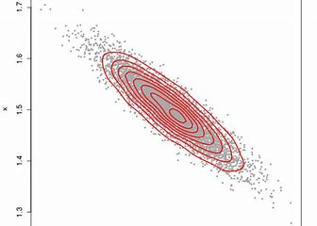
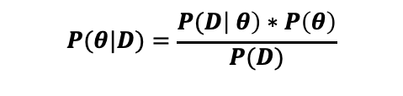
Aim 2: What is MAP, muAP, and HPD?
MAP
1 standard deviation
distance from center of Prior
$$P(θ|D)=\frac{P(D\left| θ\right)∗P\left(θ\right)}{P(D)}$$
HPD
Initial Guess: Typically
mean of Prior
μAP
Parameter 2 (Values)
Parameter 2
HPD
MAP
Parameter 1 (Values)
Parameter 1
TO DO
Run directory 2:
7
Savara, A. et. al. “Progress in Accurate Chemical Kinetic Modeling, Simulations, and Parameter Estimation for Heterogeneous Catalysis”. ACS Catal. 2019, 9, 8, 6624-6647.

Slide 8
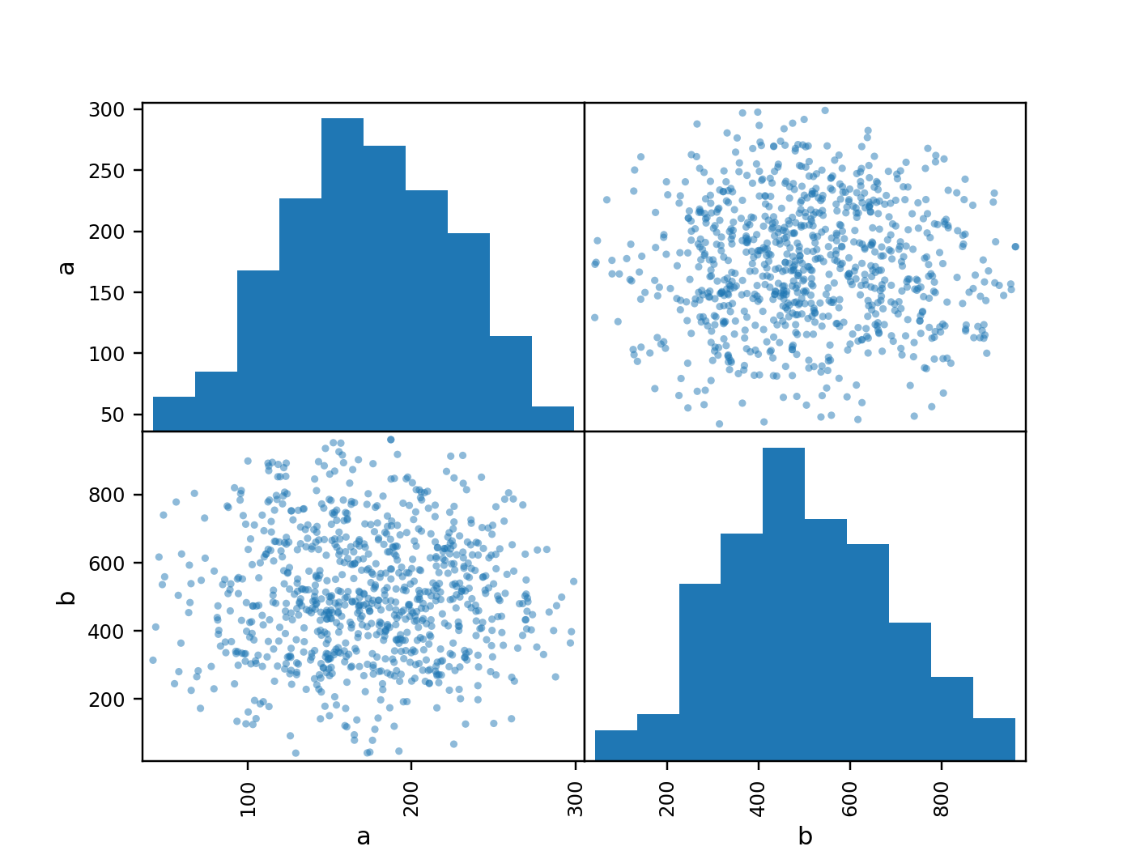
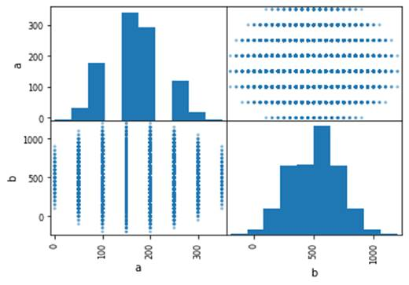
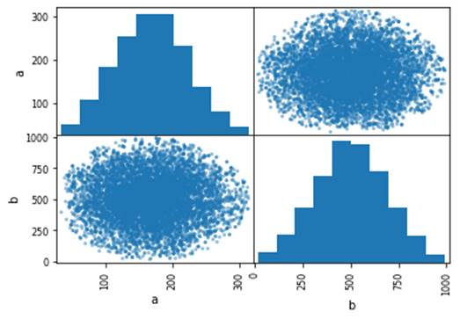
Aim 3: Introduction to different sampling methods
MCMC Sampling |  | Non-MCMC sampling
Examples: Metropolis Hastings Ensemble Slice Sampling Ensemble jump sampling |  | Examples: Grid search Uniform Shell/Astroidal/Sobol
Contains Bias to find HPD |  | Unbiased samples
MCMC is efficient in most of the cases, except for the multidimensional rough response surfaces
ESS | Grid search
Metropolis Hastings (MH)
MAP
1 standard deviation distance from center of Prior
HPD
Initial Guess: Typically
mean of Prior
Parameter 2 (Values)
Parameter 1 (Values)
AIM
Run directory 3: subdirectories ESS, and Grid search
8

Slide 9
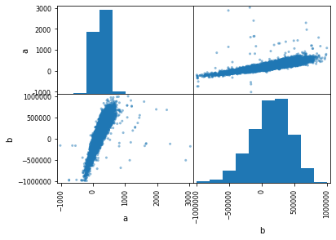
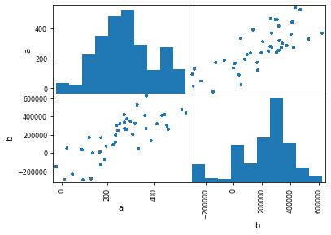
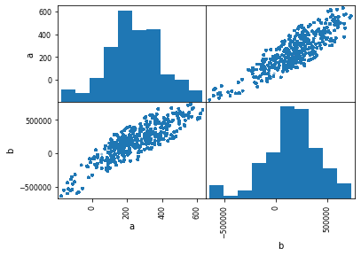
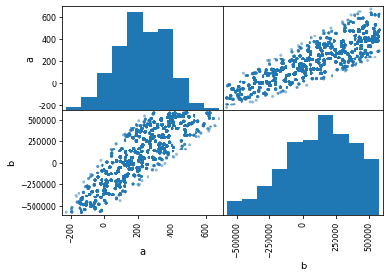
Aim 3: Develop intuition on Sampling methods
Example: | Type of MCMC: | Samples: | Est. time: | a | b
00c1 | ESS | ~1500 | ~5 seconds | 124 ± 1.7E3 | 123930 ± 3.3E5
00c2 | ESS | ~10000 | ~60 seconds | 235 ± 1.9E2 | 134329 ± 3.1E5
00c3 | MH | ~10000 | ~13 seconds | -2.4e+01 ± 1.4E2 | -3.17e+05 ± 1.9E5
00c4 | MH | ~60000 | ~50 seconds | 311 ± 1.4E2 | 278693 ± 2.3E5
00c5 | MH | ~100000 | ~80 seconds | 279 ± 1.3E2 | 218384 ± 2.0E5
00c6 | MH | ~1000000 | ~800 seconds | 243 ± 1.6E2 | 161890 ± 2.6E5
00c8 | Uniform Distribution Sampling (non-mcmc) | ~1000000 | ~990 seconds | 225 ± 1.5E2 | 125773 ± 2.6E5
00c2 (ESS)
00c5 (MH)
00c6 (MH)
00c8 (Uniform)
AIM
Run directory 3: subdirectory MH
Computational Design of Hybrid Materials (CDHM)
9

Slide 10
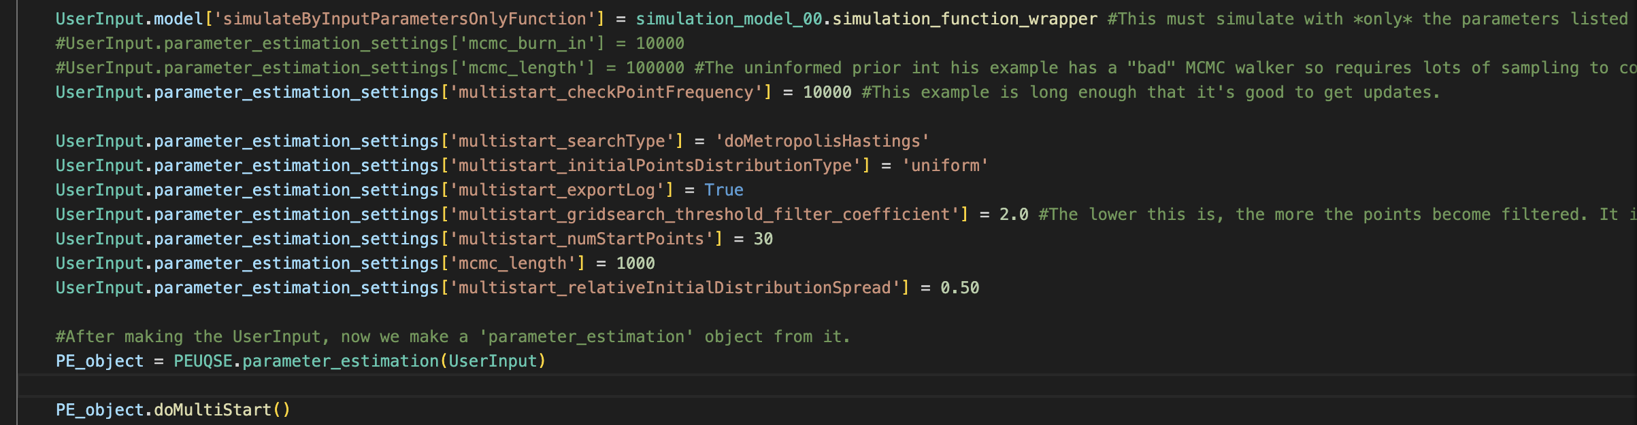
Aim 4: Multistart Feature of PEUQSE
Number of runs
How far the initial guess is spread for each run
Use key word multistart!
TO DO
Run directory 4: subdirectory ESS or MH
Computational Design of Hybrid Materials (CDHM)
10

Slide 11
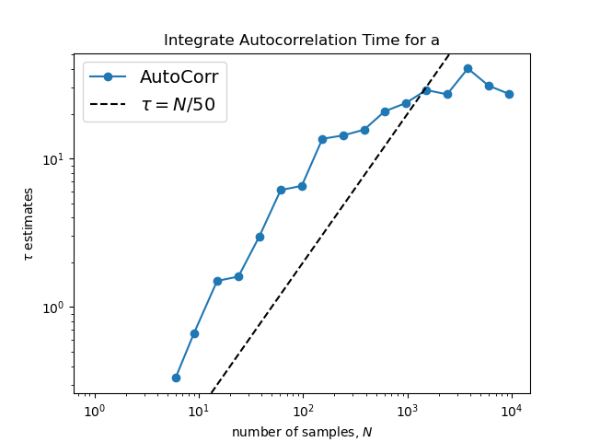
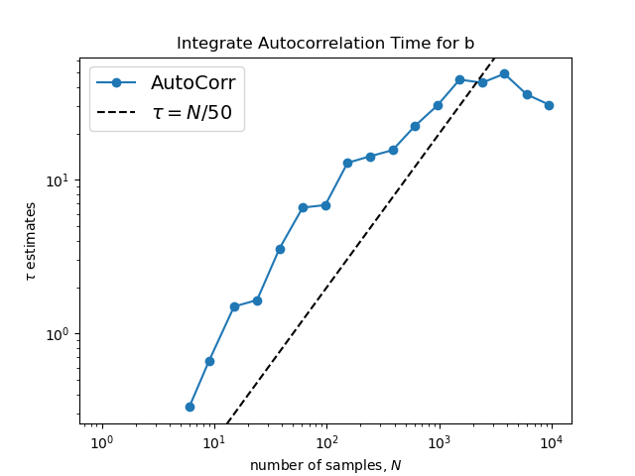

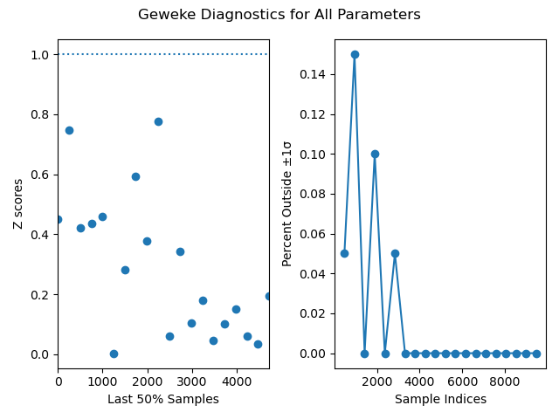
Aim 5: Familiarize yourself to convergence metrics
Autocorrelation Time (ACT)
Geweke Diagnostics
Comparison of the MAP and the mu_AP
Multiple samplers find similar solutions
TO DO
Run directory 5: Observe Geweke and AutoCorrelation Time graphs
Computational Design of Hybrid Materials (CDHM)
11

Slide 12
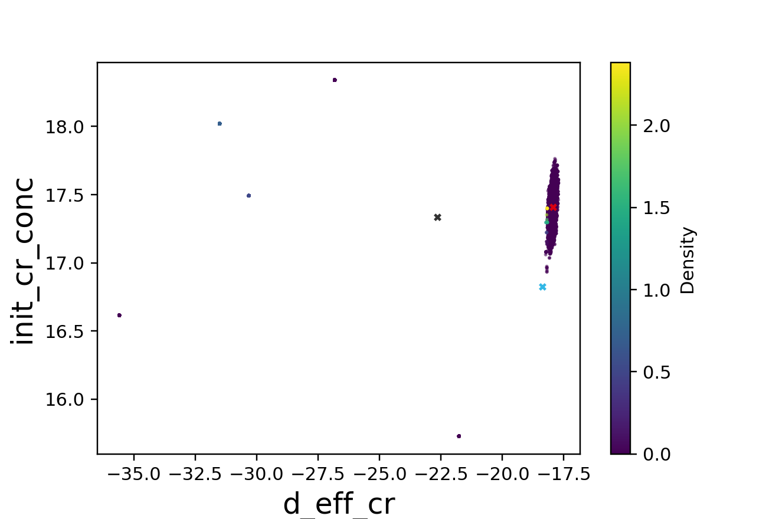
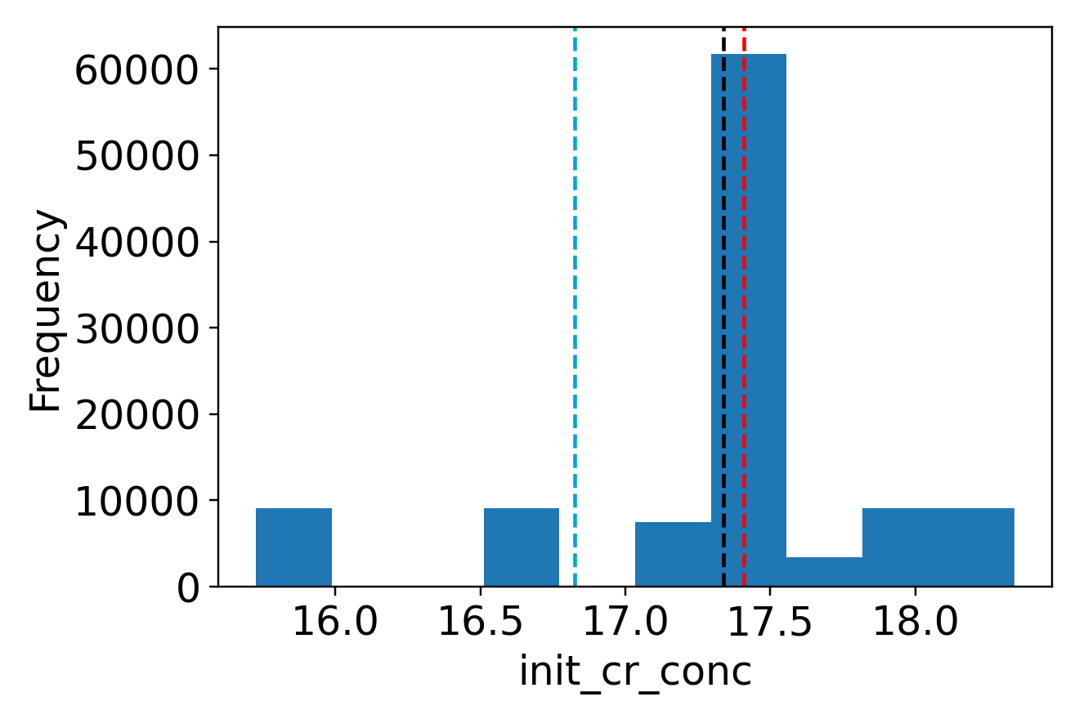
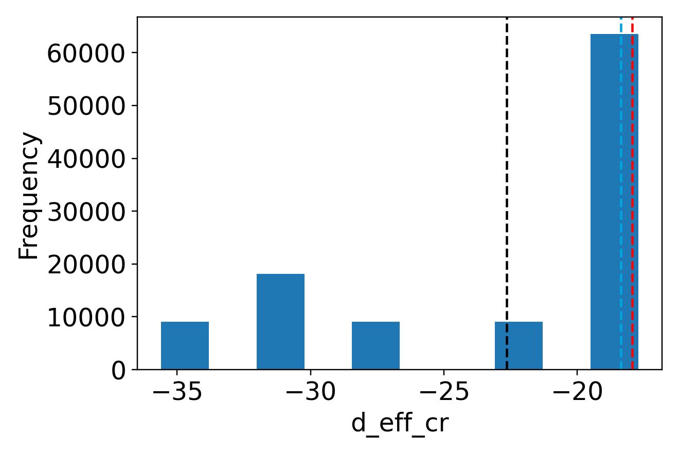
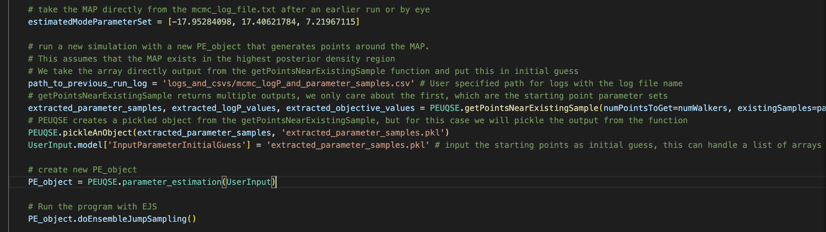
Aim 6: Stuck walkers – Restart the file
Walkers stuck in a parameter space!
Scattered points in heat scatter plots!
Multiple modes in histograms
Choose MAP or any starting point
Restart here
12

Slide 13
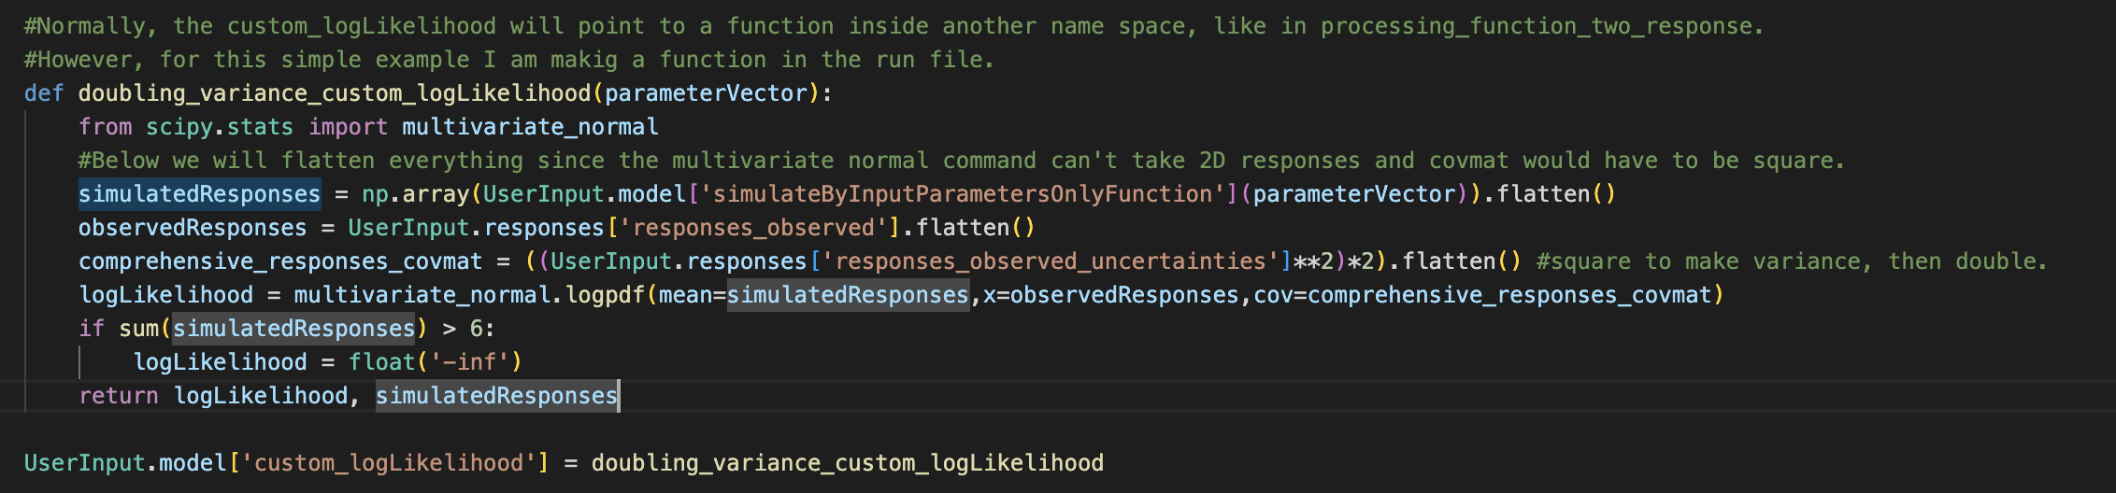
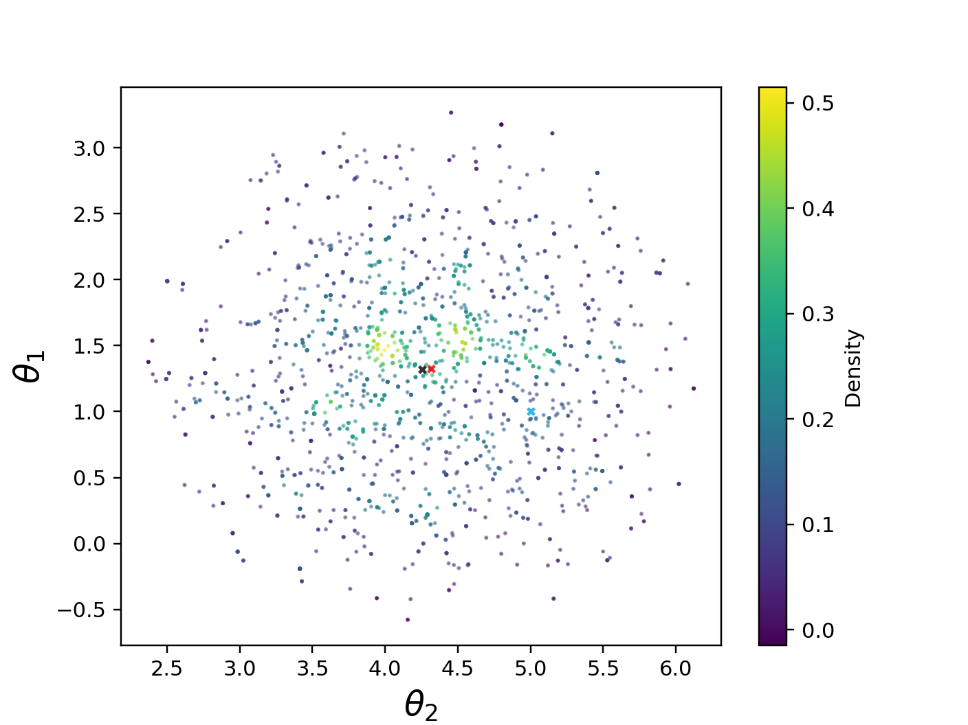
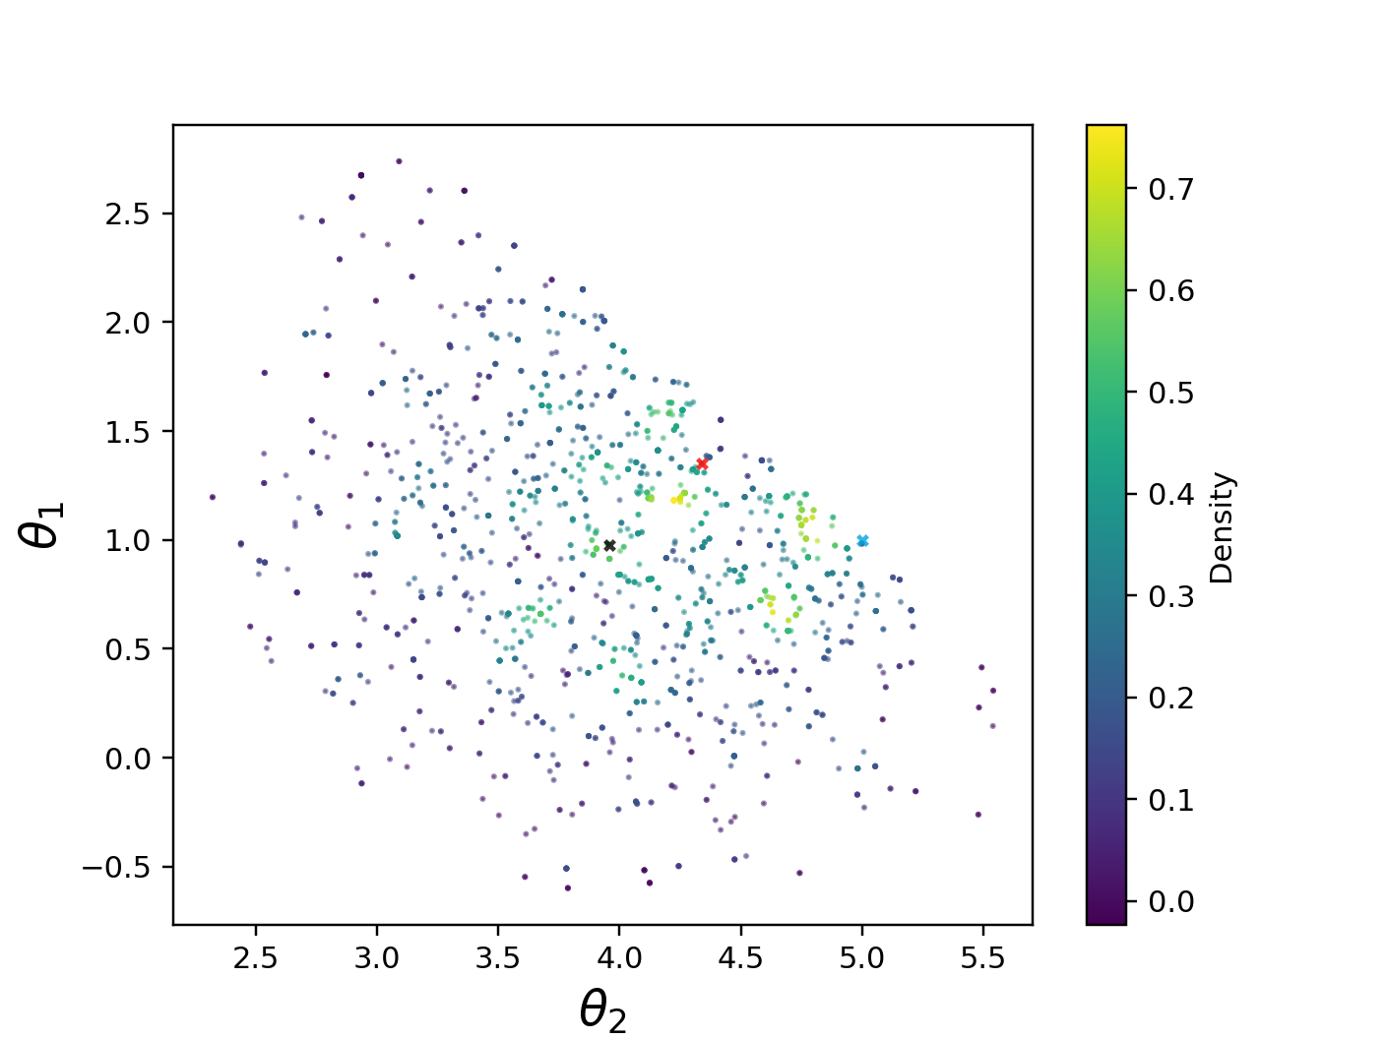
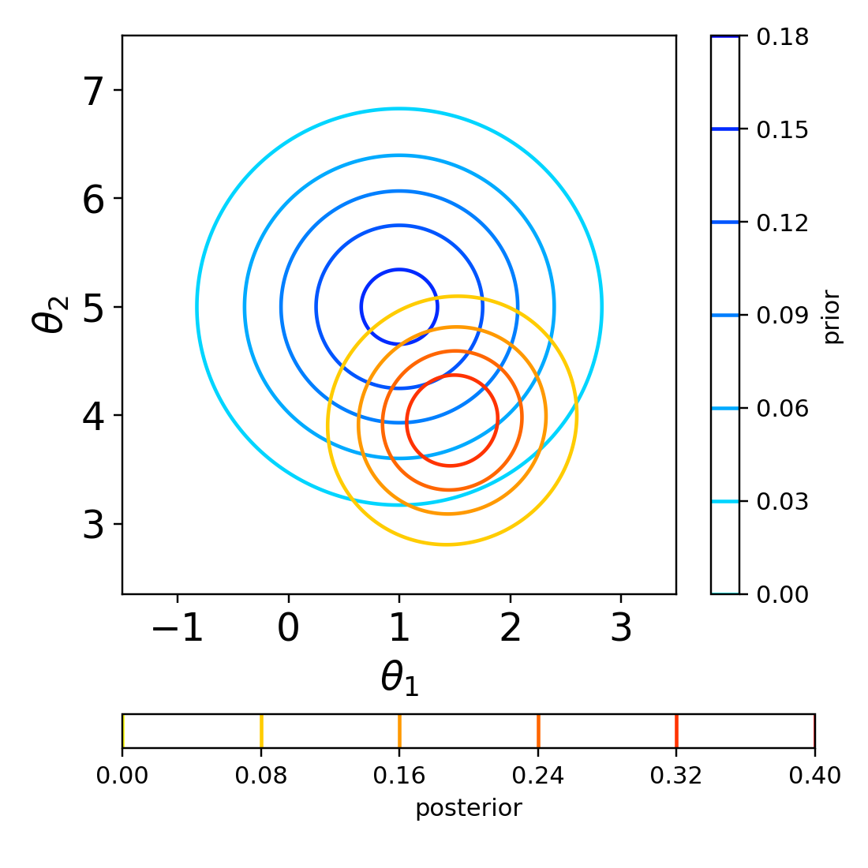
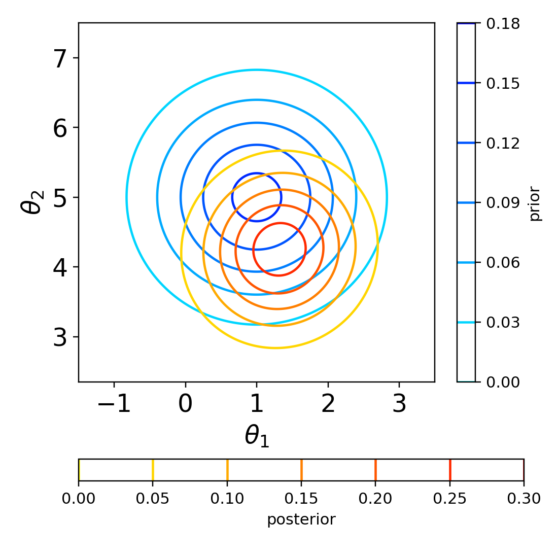
Aim 7: Custom Log likelihood
Example 7b
Example 7d
Example 7d
Example 7e
Custom Log likelihood
Variance doubled
13

Slide 14
Aim 8: Plots customization
﻿PE_object.createAllPlots( ) → creates all the plots and puts them in the ./graphs directory
PEUQSE generally puts out the plots needed, but more can be put out by changing UserInput options.
In PEUQSE directory, seeUserInput accounts for plotting options of the following plotting functions:
Scatter matrix plot:
Heat map scatter Plot
Histograms for each parameter
Simulated responses plot
Mumpce plots – Contour plots
TO DO
Run directory 8: To create mumpce plots
Computational Design of Hybrid Materials (CDHM)
14

Slide 15
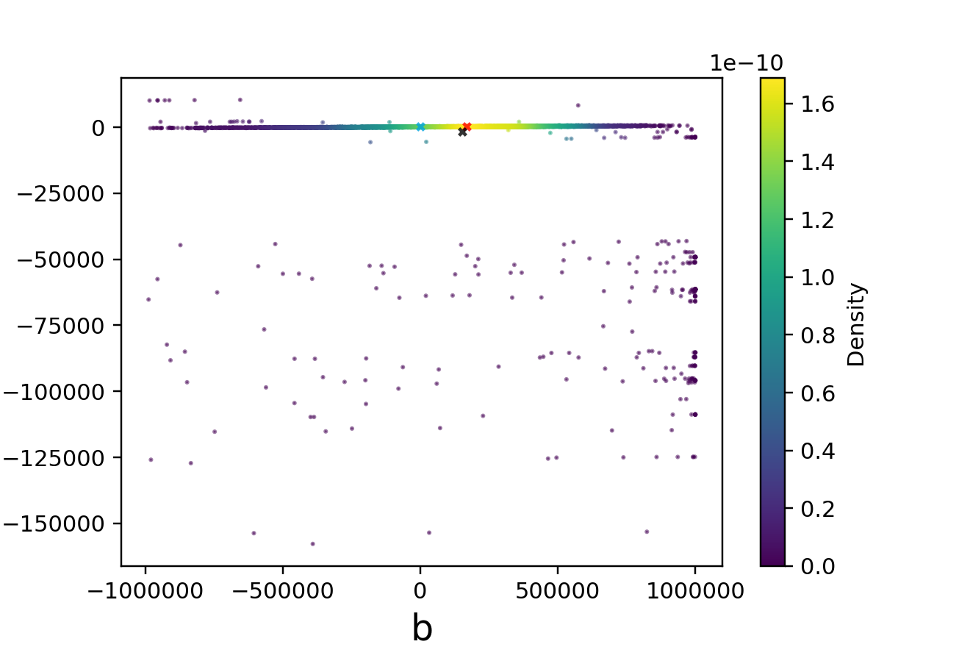
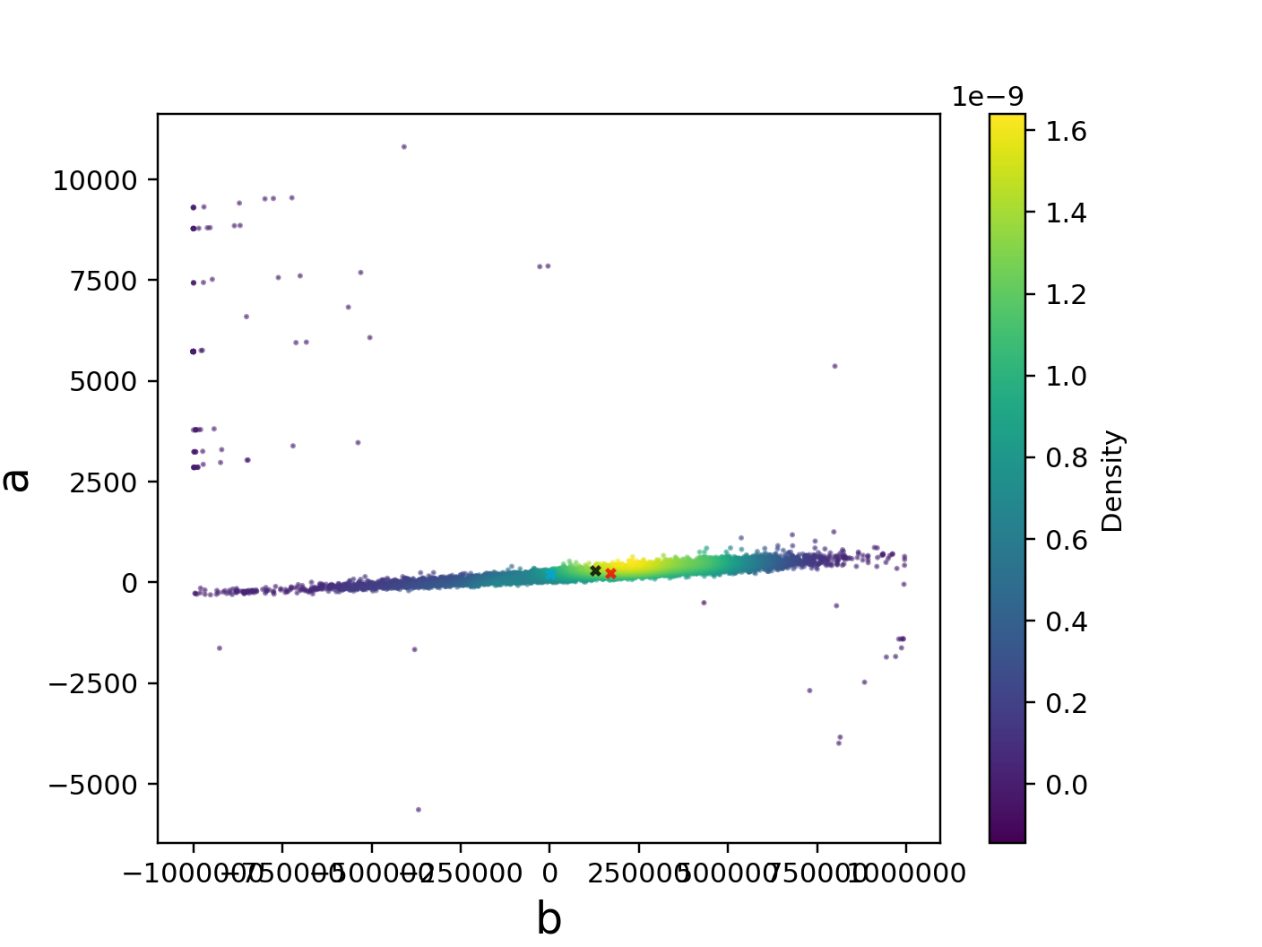
Aim 8: Filtering is necessary
Unfiltered
Filtered
﻿This filtering feature removes low probability tails from the posterior. This can be important for getting mu_AP, especially when using ESS. Default is true.
Computational Design of Hybrid Materials (CDHM)
15

Slide 16
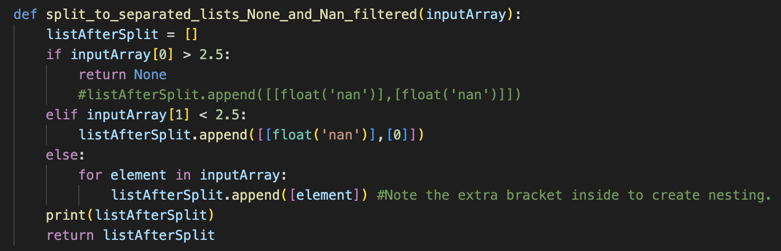
Aim 9: PEUQSE handles ‘None’ type or ‘nan’ values
Example 7n is a modification of 7a
Following Two responses are returned
If response 1 < 2.5: Return None
If response 2 > 2.5: Return ‘nan’
This function is defined in: processing_function_two_response.py
PEUQSE treats None type or nan values as zero probability point!
PEUQSE doesn’t crash!
PRO TIP: Put a try and except statement in your simulation wrapper. Return a None object when your simulation fails. If your simulation wrapper returns a None object, PEUQSE will treat that parameter set as a zero probability point.
TO DO
Run directory 9 and observe the graphs
16

Slide 17
THANK YOU!
17

Slide 18
Aim 10: Walkers allowed to pick a mode
Change the line number 51 in runfile_316_EJSresampling.py to whichever value you’d like to start the walkers around
TO DO
Run directory 10: runfile_316_EJSresampling.py
Computational Design of Hybrid Materials (CDHM)
14

